Slide 1
Case study- Agent Architecture
Ms. Swati Mali
swatimali@somaiya.edu

Slide 2
Problem Definition
Design a crime investigation agent that goes through incident narration(s) or a question-answer system to give list of suspects and if possible, culprit to the crime.

Slide 3
PEAS
Performance measure-(On the scale of 1 to 10)
Clue identification - +8
Wrong suspect - -9
Resolved case – bonus +10
Open case – penalty -10
Figured out modus operandi of similar crimes - +10
Motive identification - +6 per motive
Environment- closed room, a data entry person
Actuators- screen, printer
Sensors – keyboard, mouse, touchscreen, image reader, video processor

Slide 4
Properties of task environment
Partially observable
Stochastic
Sequential
Dynamic
Continuous
Single agent

Slide 5
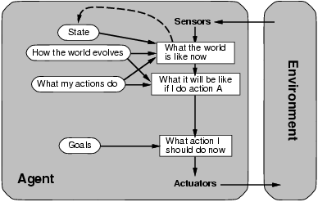
Architecture- Goal based

Slide 6
How the world evolves
Basic definitions –crime, suspect, evidence & proof, legal evidence,
Types of crimes
Evidence- fingerprint, DNA, belongings, weapons, leaving some trail behind
Different consequences of different crimes (shoplifting in minor while murder and conspiracies are serious)
Science of crime investigation
Human virtues responsible for crime – hate, jealousy, professional crime, psychological issues, money, revenge, challenge, blackmail
People- economical status, presence or absence of respect or credibility in society with money and/or education, work culture of different professions, availability of tools due to professions, knowledge about Non-tool entities which can act as tool in crime, interpersonal relations-

Slide 7
What my actions do
Action1: Find_Suspect()
Action2: Find_Culprit()
Both actions may have hundreds of rules for finding suspects and culprit based on information provided in “How the world works”
Not all the rules defined would be applicable to every story, it will vary from story to story
Information given in “How the world works” and “What my actions do” is generic(Domain knowledge)
“what the world is like right now” would be case specific

Slide 8
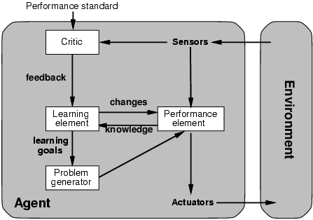
Learning agents

Slide 9
Goal based- Learning agent
Performance element –
Goal based agent
Learning element
Receives new knowledge from PE (E.g. role of mobile location in narrowing suspects in faster and better manner)
Creates a rule and adds to “How the world evolves” part so that it can be used for solving any such case; rather than solving only this case
Based on this new info, PE may choose different rule to execute in similar situation while solving another crime
or may choose to change the sequence of rules to execute while checking on suspects and culprits

Slide 10
Goal based- Learning agent
Problem generator
May make rules for unseen situations (e.g. solving a case wherein mobile location isnt available)
Use it when such a situation arises and based on the effect, may change it or accept it in “How the world evolves” part
Will learn better ways to achieve goals or sub-goal(s)
Critic
Sensors give account of situation and rewards/penalties given in performance element tells if its good, better, bad or worst
E.g. lots of suspects but no solution/ wrong clues being used etc
Learning element updates rules accordingly and changes them in “How the world works” part of performance element

Slide 11
Video recommendation system??
Design a video recommendation system on the basis of what the user’s watching history and refines the recommendations on the basis of recommendations the user has already chosen to view.
Design a video recommendation system which takes into consideration the preferences like language, genres and viewing history to display a list of recommended series/movies.

Slide 12
Design a video recommendation system based on; user views, history, previous view durations and general trends observed.

Slide 13
Properties of task environment
Oservable?
Deterministic?
Episodic?
Static?
Discrete?
Single user?

Slide 14
PEAS
P
E
A
S

Slide 15
Agent architecture(s)?

